Slide 1

CA22125 - Precision medicine in biliary tract cancer (Precision-BTC-Network)
deliverable
Presentation of the
COST DISEASE CATALOGUE
samples and data available for collaborations within the network
Coordinator: Martin Cornillet, Karolinska Institute, Sweden
martin.cornillet.jeannin@ki.se
December 2024

Slide 2
COST DISEASE CATALOGUE
AIMS
Facilitate research collaborations by:
Providing brief overview of samples and data types available
Providing contacts and ethics information

Slide 3
COST DISEASE CATALOGUE
Current contributors and content
15
institutions
300 000
10
countries
individuals
13
diseases

Slide 4
COST DISEASE CATALOGUE
Summary estimate
Patient’s TYPE with samples available
CCAs > 800
GBC > 200
Ampullary > 100
AIH > 500
Gallstones > 50
HCV > 300
HCC > 1500
Cirrhosis > 150
MASH/MASLD > 800
PBC > 300
Healthy > 25
Benign operated > 50
PSC > 800
Type of DATA available
General healthy record data, comorbidities, tumour staging, treatments, outcomes, CT/MRI, MRCP/ERCP, RNA seq, methylation, miRNA, metabolomics, proteomics, cells (LSEC, CAF, CD45+…)
others
PBC register
> 3000 individuals
Population based register
> 300 000 individuals
Type of SAMPLES available
Serum, plasma, bile, cytobrush, feces, liver biopsies from tumor and non tumor part (FFPE or fresh frozen), PBMC, blood

Slide 5
COST DISEASE CATALOGUE
Example of potential applications
“I need biological samples from diseased controls related to BTC”
“I need MRI data to train or validate an AI model for detection of BTC”
“I need biological data already generated to explore or validate a hypothesis”
“I need samples from patients with several omics data already available”
“I would like to know who has matched bile and serum samples”
“I need plasma samples from BTC patients before the diagnosis to test early diagnosis biomarker”
“I need to know who has matched tumor sequencing data and plasma samples for validation of non-invasive tumor detection markers”
“I would like multiple longitudinal samples to perform time dependant analysis”
“I need clinical data of a matched control population to compare to my results”

Slide 6
COST DISEASE CATALOGUE
What is it ? How does it work?
For contributors: “Live” Excel document allowing updates
Open to any new contributor
Very quick to fill up (only “summary level” information)
For users, Extraction of the Catalogue Version1 (2024) circulated by mail to all COST participants
An updated “version 2” will be circulated in 2025
You want to contribute? Please contact martin.cornillet.jeannin@ki.se

Slide 7
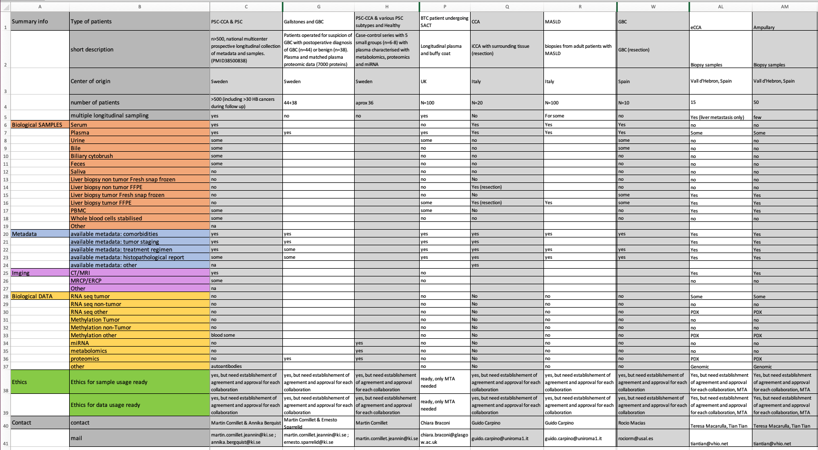
How it looks?

Slide 8
CA22125 - Precision medicine in biliary tract cancer (Precision-BTC-Network)
deliverable
Presentation of the
COST DISEASE CATALOGUE
samples and data available for collaborations within the network
Coordinator: Martin Cornillet, Karolinska Institute, Sweden
martin.cornillet.jeannin@ki.se
December 2024

